Slide 1
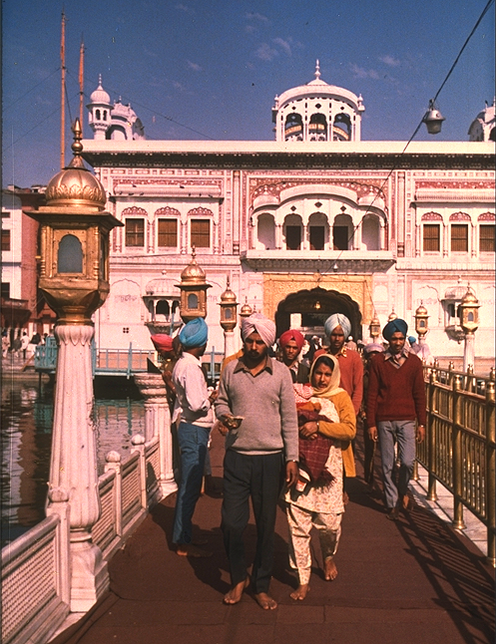

Practical Sikhism is based on three pragmatic concepts Nam Japna, Kirt Karna and Wand Chhakna. This three-fold path signifies the remembrance of "The Name" performing honest labour for a living and sharing one's earnings with others. All is to be practised in daily life.

Slide 2
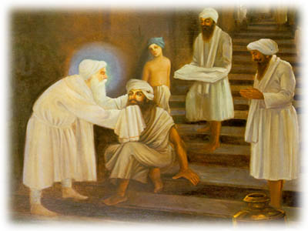
Guru Amardas Ji advised Bhai Budda regarding an ideal Sikh's life. Some of the points are mentioned below:
A Sikh should serve the people and not touch money or property belonging to others.
Let him share his joys and sorrows with his neighbours.
He should eat only when he feels hungry and sleep only when he feels sleepy.

Slide 3
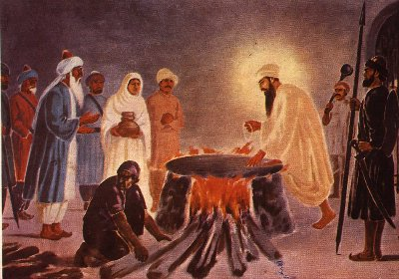
Let him resign himself to the Will of God and never find fault with any doings of his Creator.
He should keep away from lust, anger and greed, not boast of his goodness or kindness.
He shall practise charity and personal cleanlines.
He should not tolerate any irreverance towards the Gurus.
In short, let him mould his life and conduct according to the Guru's teachings.
ACCEPTING WILL OF GOD

Slide 4
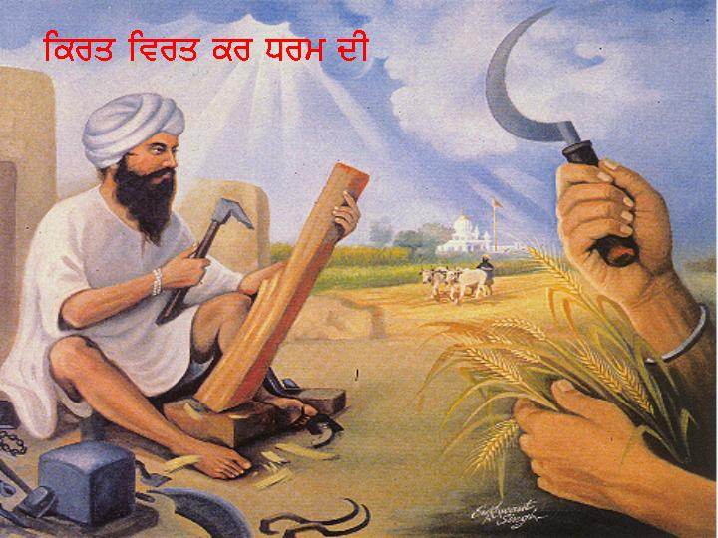
Guru Ramdas Ji laid down the following routine for a true Sikh.
Let the Sikh get up at dawn and after bathing, meditate on the Divine Name and continue his meditation till sunrise.
Then go out to earn his daily bread by honest means.
Let his calling or work be such that it keeps him away from unfair and untruthful means.

Slide 5
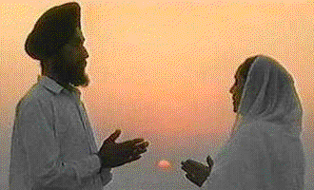
Let him repeat "The Name" or Gurbani while working or walking.
After his day's work, let him again offer prayers before retiring for the night.
The Guru seeks the dust of the feet of those who remember God's Name an who also encourage others to repeat "The Name".

Slide 6
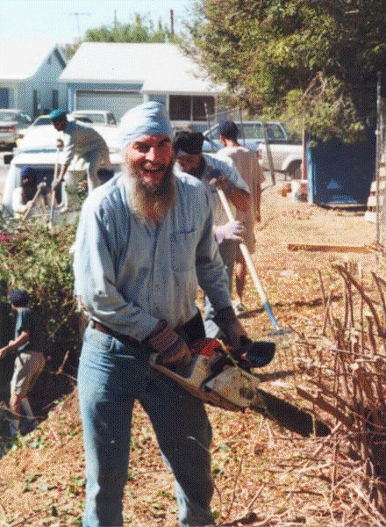
The recommended pattern of life is that of a householder: Grahastimai-udas.
The devotee should learn to remain contented and desireless while leading his life as a citizen.
Let him raise himself above worldly temptation and become a model for others.
With the Guru's Grace, he will lead a pious and clean life.
It is a great advantage to maintain a diary of one's daily actions.
Such a practice will deter one from bad deeds.

Slide 7
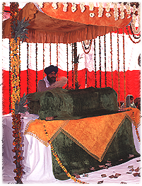
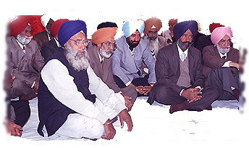
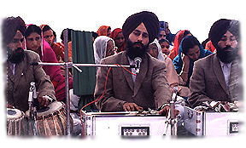
Moreover, whenever convenient one should join the Sadh Sangat for Kirtan and Katha.
Man amasses the dust of sin through numerous lives, his cleaning process will also be a long and arduous one.

